Slide 1
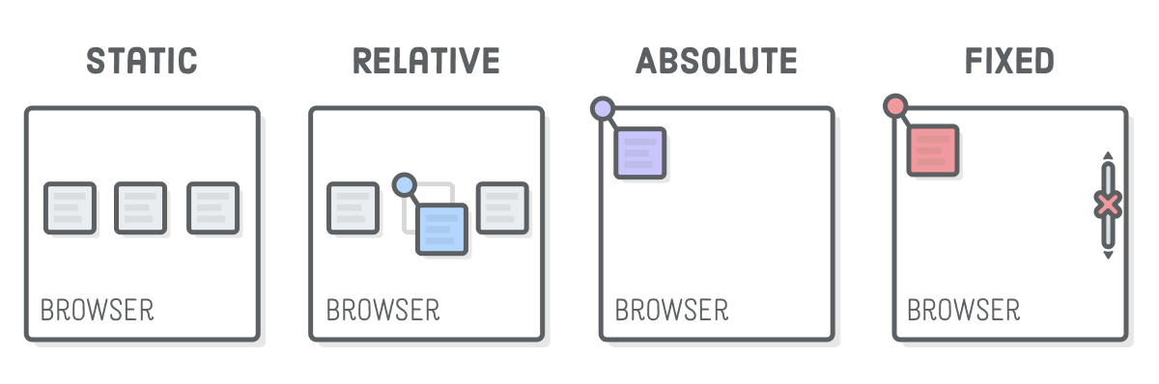
Position & Float
CSS Positioning
SoftUni Team
Technical Trainers
Software University
https://softuni.org

Slide 2
Table of Contents
Float property
Clear property
Position: static, relative, absolute, fixed and sticky
Positioning Properties
Z-index
2
Notes:
2

Slide 3
Have a Question?
sli.do
#front-end
Notes:
3

Slide 4
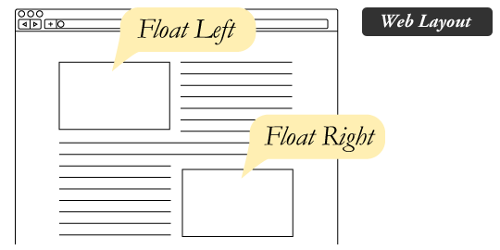
Float Property
Places an element on the left or right side of its container

Slide 5
What is Float?
Property that forces any element to float inside its parent body with the rest of the element to wrap around it
right
left
none
inherit
The element is removed from the normal flow of the page, though remaining a part of the flow
5

Slide 6
Float Property
Float values:
float: right; - floats the element to right of its container
float: left; - floats the element to left of its container
float: none; - it will restrict the element to float
float: initial; - the element remains to its default position
float: inherit; - enables the element to inherit the property from its parent element

Slide 7
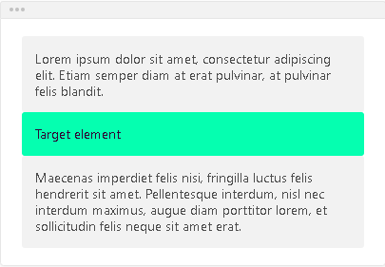
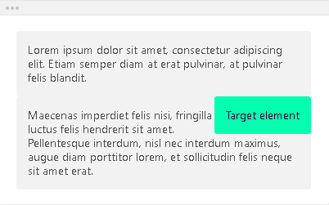
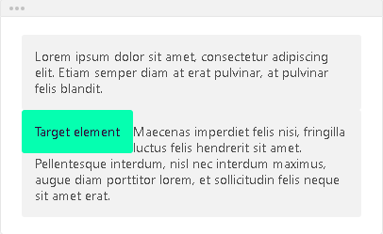
Float Properties - Example
float: none;
float: right;
float: left;

Slide 8

Floating Multiple Elements
<body>
<img class="img" src="girl.png" />
<img class="img" src="music.png" />
<img class="img" src="mug.png" />
<img class="img" src="nature.png" />
</body>
.img {
float: left;
width: 150px;
height: 100px;
margin: 5px;
}

Slide 9
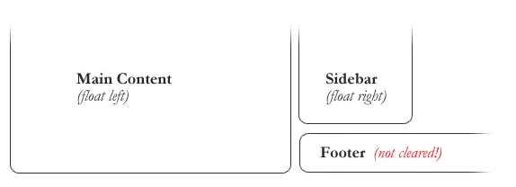
Clearing the Float
The clear property specifies on which sides of an element floating elements are NOT allowed to float
General rule for dealing with float: When you add float, always make sure that it is cleared properly. At the time of adding it.

Slide 10
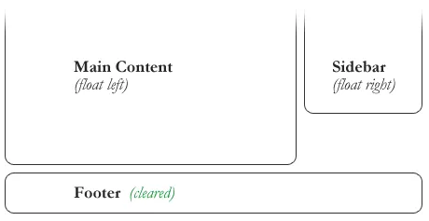
Clearing the Float
In the previous example, the sidebar is floated to the right and is shorter than the main content area
The footer can be cleared to so that it stays under both floated columns
footer {
clear: both;
}

Slide 11
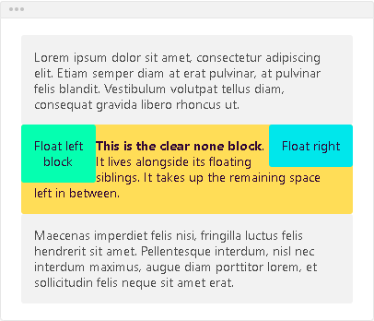
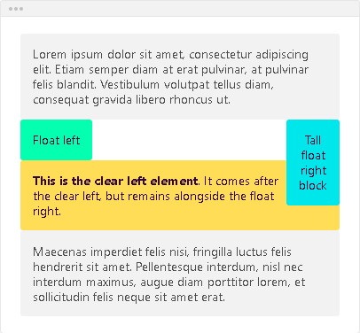
Float Clear Property
The clear property has four values:
clear: none;
clear: left;

Slide 12
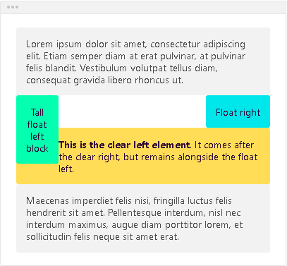
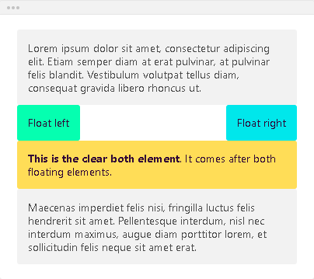
Float Clear Property (2)
clear: right;
clear: both;

Slide 13
Position
Specifies the type of positioning method used for an element

Slide 14

Position
Position properties:
static
relative
absolute
fixed
sticky

Slide 15
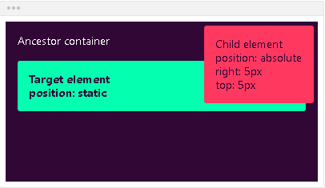
Position Static
Static - the default state of every element
Puts the element into its normal position in the document layout flow
It will NOT react to the following properties: top, bottom, left, right, z-index
div {
position: static;
}

Slide 16
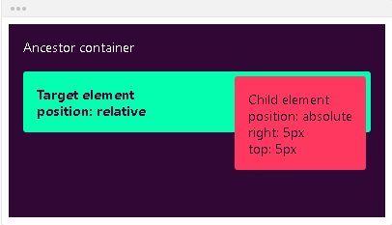
Position Relative
It looks like static positioning but once the positioned element has taken its place, you can then modify its final position with the positional properties
div {
position: relative;
}

Slide 17
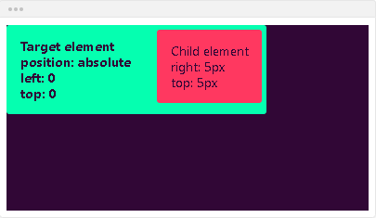
Position Absolute
Absolute - the element will NOT remain in the natural flow of the page
Reacts to the positional properties
It will positon itself according to the closest positioned ancestor
div {
position: absolute;
}

Slide 18
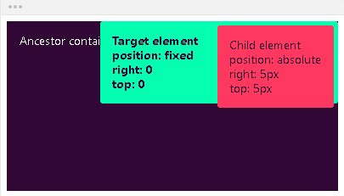
Position Fixed
Fixed - the element will NOT remain in the natural flow of the page
Reacts to the positional properties
Positions itself according to the viewport
div {
position: fixed;
}

Slide 19
Position Sticky
The element is positioned based on the user's scroll position
A sticky element switches between relative and fixed, depending on the scroll position
It is positioned relative until a given offset position is met in the viewport - then it ''sticks'' in place (like position: fixed)

Slide 20
Position Sticky - Example
.main-container {
max-width: 600px;
margin: 0 auto;
border: 10px solid green;
padding:10px;
margin-top:40px;
} .main-header,
.main-content,
.main-footer {
padding: 10px;
background: #aaa;
border: 5px dashed #000;
margin: 20px 0;
}
<main class="main-container">
<header class="main-header">
HEADER
</header>
<div class="main-content">
MAIN CONTENT
</div>
<footer class="main-footer">
FOOTER
</footer>
</main>

Slide 21
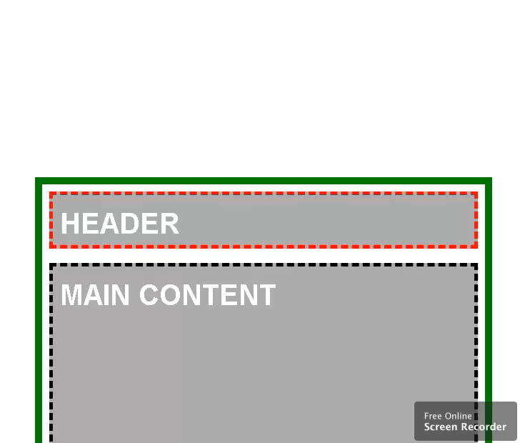
Position Sticky - Example
.main-content {
min-height: 1000px;
}
.main-header {
height: 50px;
border-color: red;
position: sticky;
top: 0;
}

Slide 22
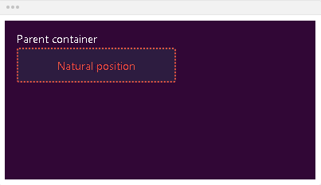
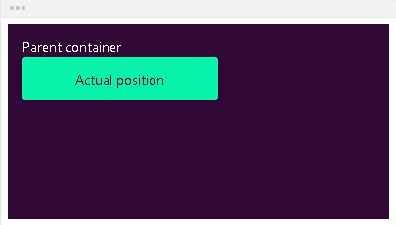
Bottom
Bottom - defines the position of the element according to its bottom edge
bottom: auto; - the element will remain in its natural position

Slide 23
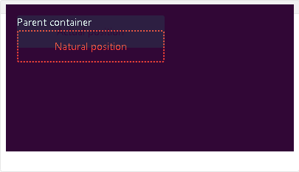
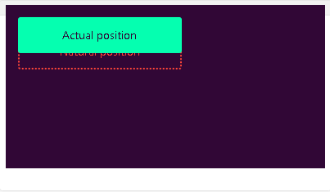
Bottom
If the element is in position relative, the element will move upwards by the amount defined by the bottom value
bottom: 20px;

Slide 24
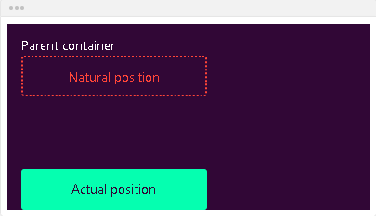
Bottom
If the element is in position absolute, the element will position itself from the bottom of the first positioned ancestor
bottom: 0;

Slide 25
Left
Defines the position of the element according to its left edge
left: auto; - the element will remain in its natural position

Slide 26
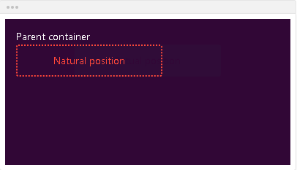
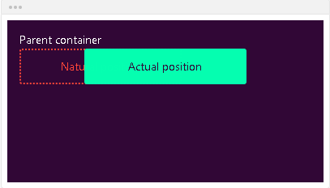
Left
left: 80px; - if the element is in position relative, the element will move left by the amount defined by the left value

Slide 27
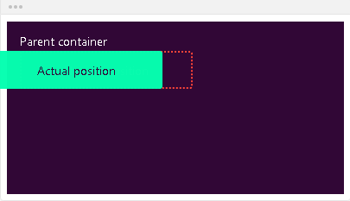
Left
left: -20px; - if the element is in position absolute, the element will position itself from the left of the first positioned ancestor

Slide 28
Right
Right - defines the position of the element according to its right edge
right: auto; - the element will remain in its natural position
right: 80px; - if the element is in position relative, the element will move right by the amount defined by the right value
right: -20px; - if the element is in position absolute, the element will position itself from the right of the first positioned ancestor

Slide 29
Top
Top - defines the position of the element according to its top edge
top: auto; - the element will remain in its natural position
top: 20px; - if the element is in position relative, the element will move downwards by the amount defined by the top value
top: 0; - if the element is in position absolute, the element will position itself from the top of the first positioned ancestor

Slide 30
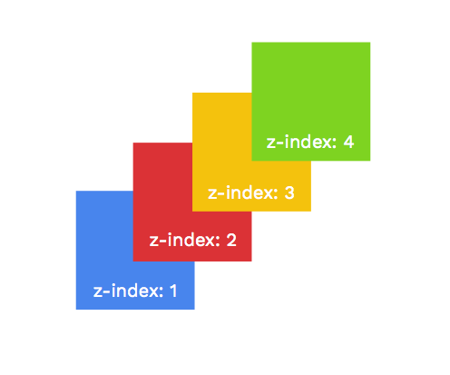
Z-Index
Specifies the stack order of an element

Slide 31
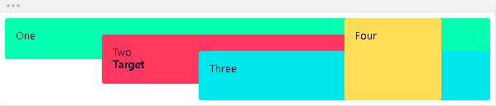
Z-index
Defines the order of the elements on the z-axis. It only works on positioned elements (anything apart from static)
Default value: z-index: auto;
The order is defined by the order in the HTML code:

Slide 32
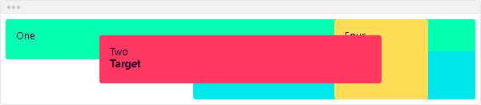
Z-index
The z-index value is relative to the other ones
The target element is move in front of its siblings
z-index: 1;

Slide 33
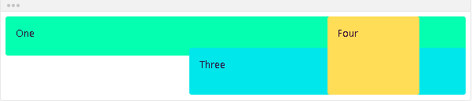
Z-index
You can use negative values
The target element is move in behind its siblings
z-index: -1;

Slide 34

Summary
Float CSS Property
How to float elements?
Float clear property
Positioning properties
Z-Index
Notes:
34

Slide 35
Questions?
Notes:
35

Slide 36














SoftUni Diamond Partners

Slide 37

License
This course (slides, examples, demos, exercises, homework, documents, videos and other assets) is copyrighted content
Unauthorized copy, reproduction or use is illegal
© SoftUni – https://softuni.org
© Software University – https://softuni.bg
Notes:
37

Slide 38
Trainings @ Software University (SoftUni)
Software University – High-Quality Education, Profession and Job for Software Developers
softuni.bg
Software University Foundation
softuni.foundation
Software University @ Facebook
facebook.com/SoftwareUniversity
Software University Forums
forum.softuni.bg
Notes:
38

